Slide 1

COIS 3320: Fundamentals of Operating Systems
Alaadin Addas
Week 6
Deadlocks, Midterm Information

Slide 2
Overview
Announcements/Reminders
Recap
Deadlock
A System Model for Deadlocks
Deadlock Detection
Dynamic Deadlock Avoidance
Static Deadlock Prevention
Summary
Midterm Information

Slide 3
Announcements/Reminders
A1 marks have been released
I will release the solutions to the questions on ZyBooks.
Lab 2 marks will be released soon.
Assignment 2 will be released today and will be due in exactly 2 weeks.
I delayed the release on purpose.

Slide 4
Recap
What are two common synchronization problems?
What is a semaphore used for?

Slide 5
Deadlock
A deadlock is a state where the processes/threads in a system are incapable of executing an action because they keep blocking each other.
Typically, this error occurs because each process or thread wants to acquire a lock to a resource that is already locked by another process/thread.
In some cases, a process/thread can deadlock itself.
How might a process or a thread deadlock itself?

Slide 6
System Model for Deadlocks
We can use Resource Allocation Graphs to show the current allocation of resources to processes and the current requests by processes for new resources.
In a resource allocation graph:
Processes are represented by circles.
Resources are represented by rectangles. If a resource contains multiple units then each unit is represented by a small circle.
Resource allocations are represented by edges directed from a resource to a process.
Resource requests are represented by edges directed from a process to a resource.

Slide 7
Blocked
We can tell if a process/thread is blocked on a resource allocation graph if one or more request edges directed from a process to a resource exist and the resource does not contain sufficient free units to satisfy all requests.

Slide 8
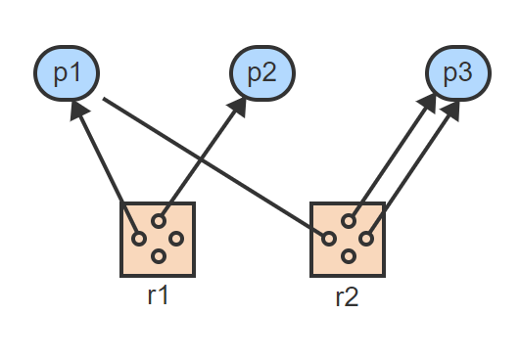
Resource Allocation Graph – 1
Three processes are sharing 2 resources, each containing 4 identical units

Slide 9
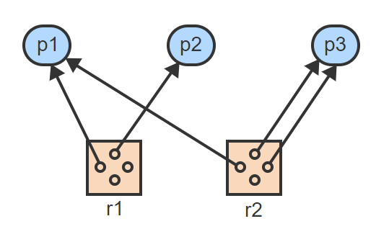
Resource Allocation Graph – 2
p1 is holding 1 unit of r1 and 1 unit of r2. p2 is holding 1 unit of r1. p3 is holding 2 units of r2

Slide 10
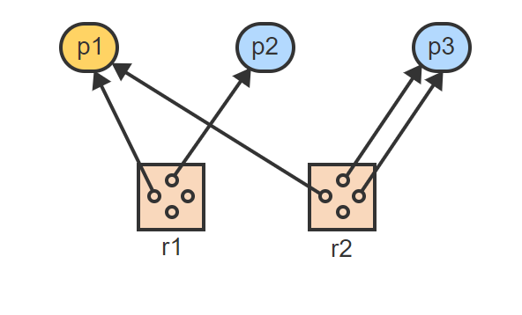
Resource Allocation Graph – 3
p1 has no outstanding requests and thus is not blocked

Slide 11
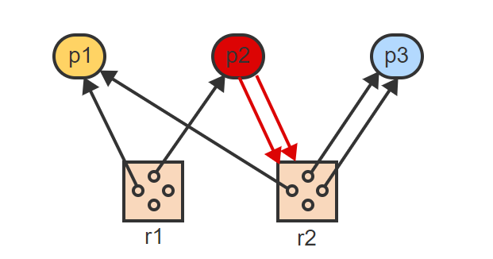
Resource Allocation Graph – 4
p2 has outstanding requests for 2 units of r2. Since only 1 unit is available, p2 is blocked

Slide 12
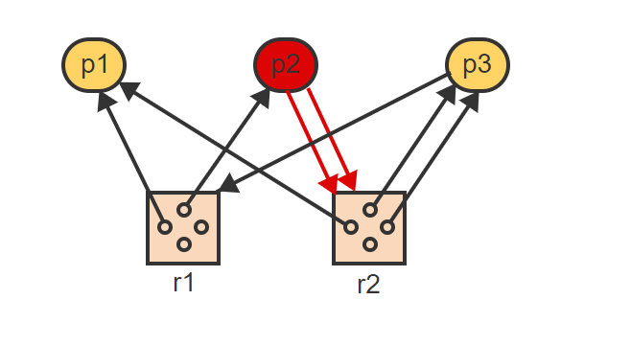
Resource Allocation Graph – 5
p3 has an outstanding request for 1 unit of r1. Since units of r1 are still available, p3 is not blocked

Slide 13
Deadlocks With Reusable Resources
A reusable resource r contains one or more identical units, each of which may be requested and used by a process on a non-shared basis.
A deadlock involves at least 2 processes and 2 resources, where each process holds one resource and is blocked indefinitely on another resource held by another process.

Slide 14
State Transitions
A resource allocation graph represents the current state of the system.
Three operations move the system into a new state, represented by a different resource allocation graph:
Resource Request
Resource Transition
Resource Release

Slide 15
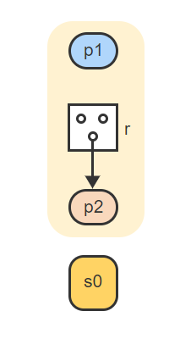
State Transitions – Visualized – 1
In state s0, process p2 is holding 1 unit of resource r

Slide 16
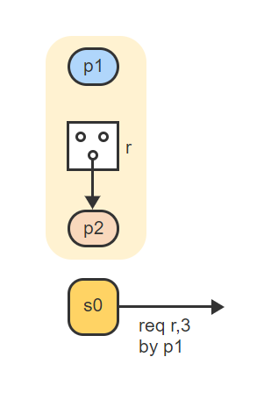
State Transitions – Visualized – 2
Process p1 requests 3 units of resource r

Slide 17
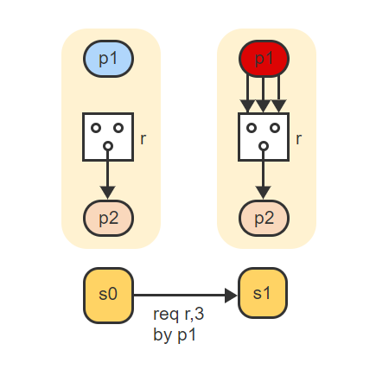
State Transitions – Visualized – 3
The system enters a new state s1, where p1 is blocked because only 2 units of r are available

Slide 18
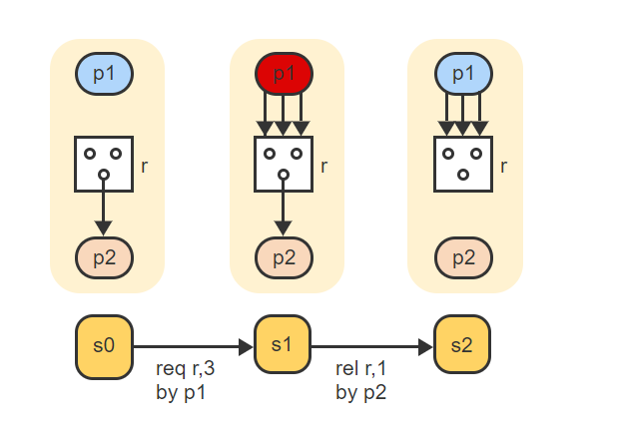
State Transitions – Visualized – 4
p2 releases one unit of r, taking the system into a new state s2, where p1 is no longer blocked because all 3 units are available

Slide 19
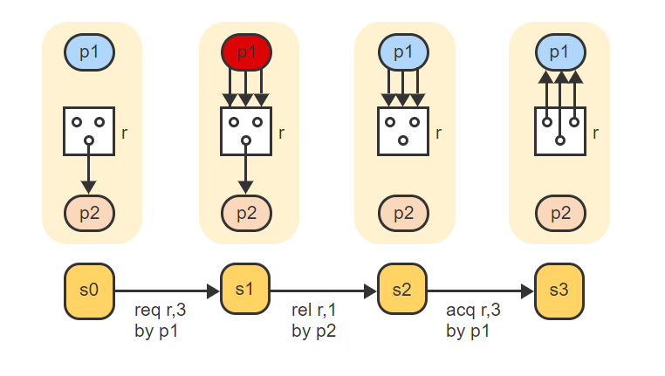
State Transitions – Visualized – 5
p1 can now acquire all 3 units of r and the system enters a new state s3. Alternately, p2 could request 1, 2, or 3 units of r, each of which would take the system into a different state

Slide 20
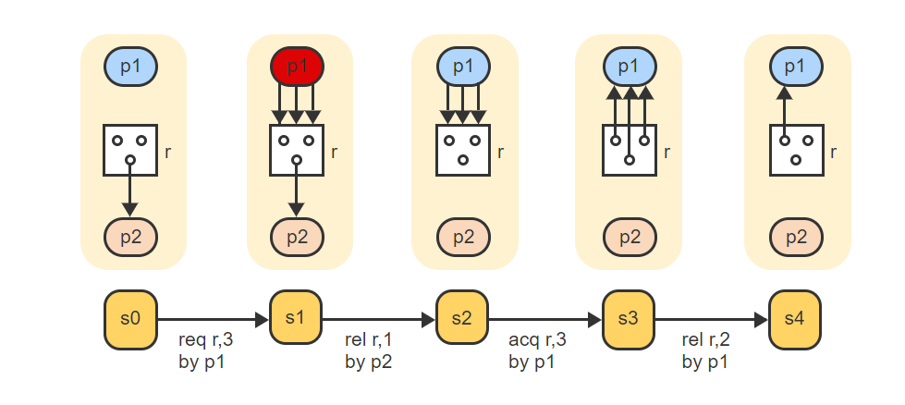
State Transitions – Visualized – 6
In state s3, p2 could again request 1, 2, or 3 units of r, or p1 could release 1, 2, or 3 units of r, each leading into a new state. If p1 releases 2 of the 3 units then both processes remain unblocked in state s4

Slide 21
Deadlock States & Safe States
A process is deadlocked in a state s if the process is blocked in s and if no matter what state transitions occur in the future, the process remains blocked.
A state s is called a deadlock state if s contains two or more deadlocked processes.
A state s is a safe state if no sequence of state transitions exists that would lead from s to a deadlock state.
When the sequence of all requests and releases by each process is known, a complete state transition graph can be constructed and analyzed for the presence of deadlock states and safe states.

Slide 22
Deadlock Detection
So how can we detect a deadlock?
A deadlock in a resource allocation graph can be detected by executing a graph reduction algorithm:
Repeat until no unblocked process remains in the graph:
Select an unblocked process p.
Remove p, including all request and allocation edges connected to p.
A resource allocation graph is completely reducible if at the termination of the graph reduction algorithm all processes have been deleted.
Theorem 1: A state s is a deadlock state if and only if the resource graph of s is not completely reducible.
Theorem 2: All reduction sequences of a given resource allocation graph lead to the same final graph.
The consequence of the two theorems is that any sequence of reductions will determine whether a given resource allocation graph represents a deadlock state.

Slide 23
Theorem
What is a theorem?
In mathematics, a theorem is a non-self-evident statement that has been proven to be true, either based on generally accepted statements such as axioms or based on previously established statements such as other theorems [1].

Slide 24
Graph Reduction Algorithm
Dr. Richard C. Holt Introduced a graph reduction method to check if a process is deadlocked in the early 70s.
Great resource to read:
Richard C. Holt. 1972. Some Deadlock Properties of Computer Systems. ACM Comput. Surv. 4, 3 (Sept. 1972), 179–196. DOI: https://doi.org/10.1145/356603.356607

Slide 25
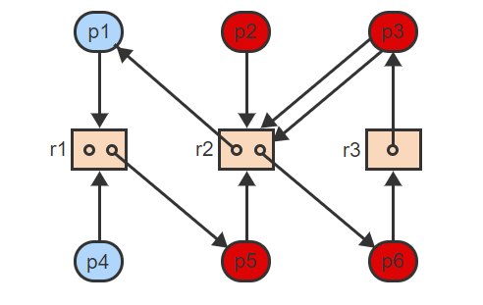
Reduction of A Resource Allocation Graph – 1
Processes p1 and p4 are not blocked because 1 unit of r1 is available and thus each request can be satisfied in turn. The remaining processes are all blocked

Slide 26
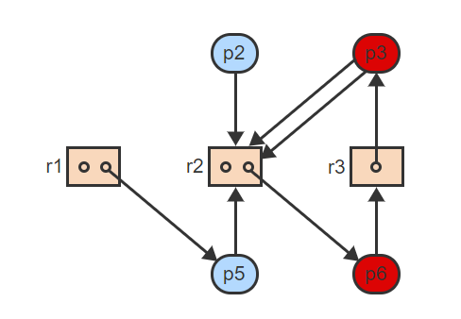
Reduction of A Resource Allocation Graph – 2
Both p1 and p4 can be removed in either order, which unblocks processes p2 and p5

Slide 27
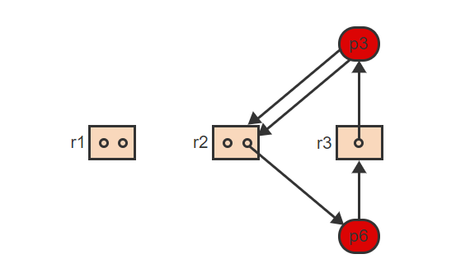
Reduction of A Resource Allocation Graph – 3
p2 and p5 can now be removed from the graph. However, p3 and p6 remain blocked. The graph is not completely reducible and represents a deadlock state

Slide 28
Continuous Deadlock Detection
Testing for deadlock can be accomplished more efficiently if done on a continuous basis. If the current state s is not deadlocked, then the next state s' can be a deadlock state only if:
The operation that caused the transition was a request for a resource &
The process p that issued the request is deadlocked in s’.
Continuous deadlock detection then proceeds as follows:
If the current operation is a request for a resource and the requesting process p becomes blocked in s' then execute the graph reduction algorithm until:
Either p is removed from the graph.
Or no unblocked process remains in the graph.
If p is removed then s' is not a deadlock state and the algorithm terminates.

Slide 29
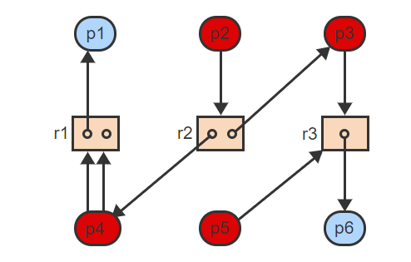
Continuous Deadlock Detection Visualized – 1
During continuous deadlock detection, the current state s is not a deadlock state

Slide 30
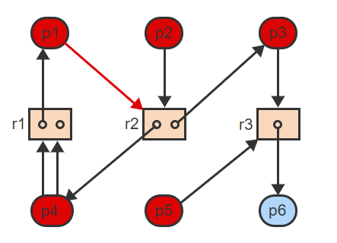
Continuous Deadlock Detection Visualized – 2
If p1 requests r2, then p1 becomes blocked and graph reduction must be performed

Slide 31
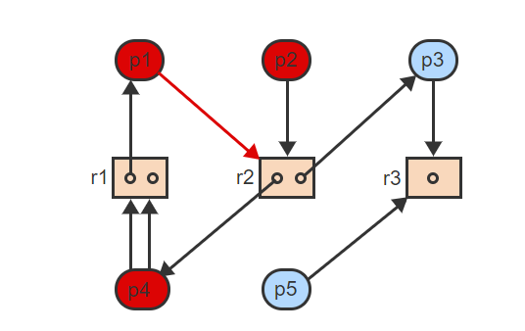
Continuous Deadlock Detection Visualized – 3
The graph reduction algorithm removes p6, which unblocks p3 and p5

Slide 32
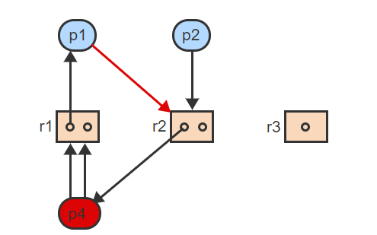
Continuous Deadlock Detection Visualized – 4
The next step can remove p3 and p5, which unblocks p1 and p2

Slide 33
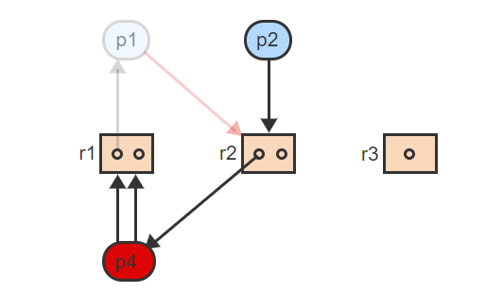
Continuous Deadlock Detection Visualized – 5
Since p1 can now be removed, the graph reduction algorithm can stop

Slide 34
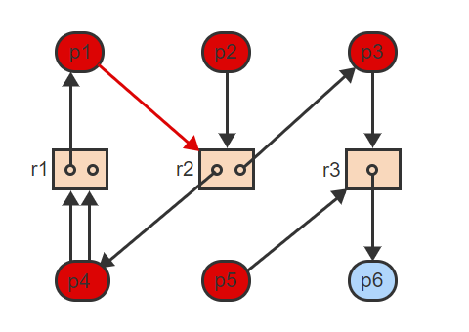
Continuous Deadlock Detection Visualized – 6
The new state s' is not a deadlock state

Slide 35
Deadlock Detection W/ Single-Unit Resources
With a single-unit resource r, only a single allocation edge can exist between r and a process p.
For the purpose of deadlock detection, the resource can be removed from the graph along with the allocation edge.
Each request edge then points directly at the process currently holding the resource.
A wait-for graph is a resource allocation graph containing only processes where each process can have multiple incoming resource allocation edges but only one outgoing resource request edge.
The term "wait-for" indicates that process p is blocked on a resource currently held by another process p'.

Slide 36
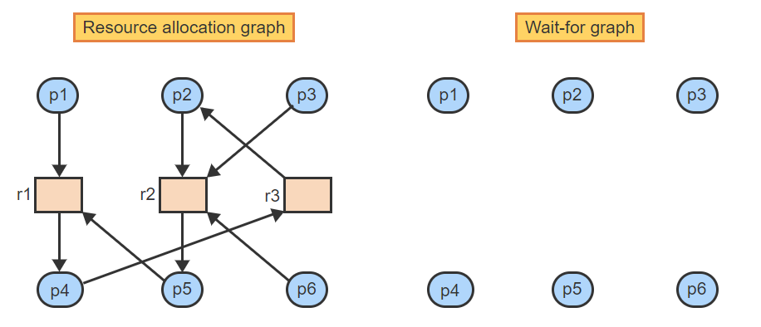
Wait For Graph – Visualized – 1
All 3 resources are single-unit resources and are removed in the wait-for graph

Slide 37
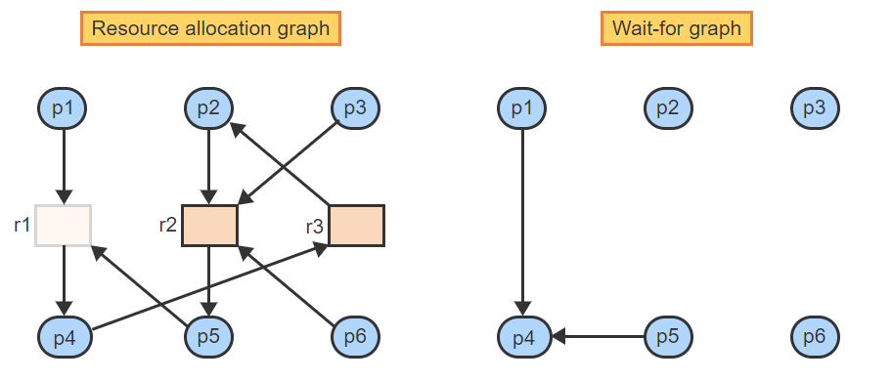
Wait For Graph – Visualized – 2
p1 and p5 are requesting r1, which is held by p4. Thus p1 and p5 are waiting for p4. When r1 is removed, the wait-for edges show the dependencies from p1 and p5 to p4

Slide 38
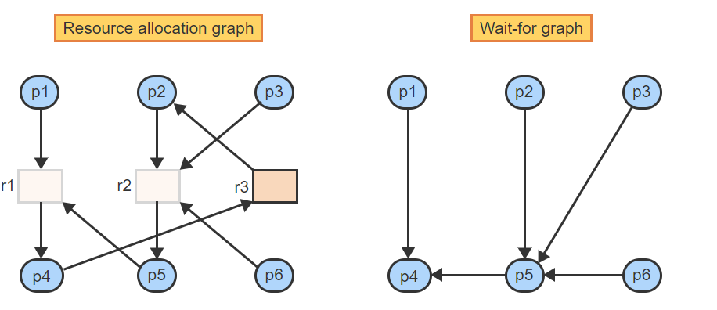
Wait For Graph – Visualized – 3
p2, p3, and p6 are all requesting r2, which is held by p5. Thus p2, p3, and p6 are waiting for p5. When r2 is removed, the wait-for edges show the dependencies

Slide 39
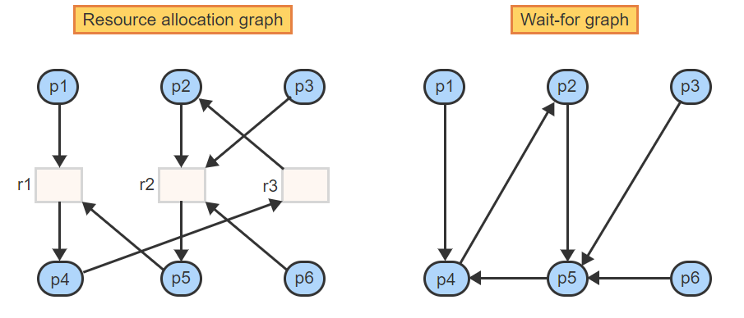
Wait For Graph – Visualized – 4
Finally, p4 is requesting r3, which is held by p2. When r3 is removed, the new edge shows the dependency from p4 to p2

Slide 40
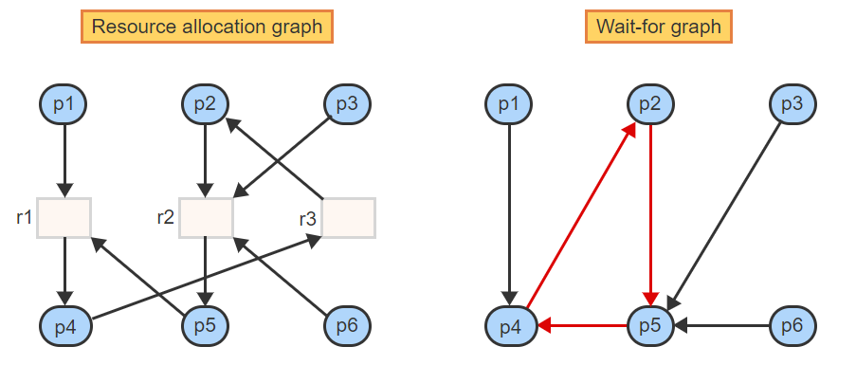
Wait For Graph – Visualized – 5
The cycle in the wait-for graph reveals that the state is a deadlock state. All processes are blocked indefinitely

Slide 41
Wait For Graph – Theorem
Based on the visualized we just went through:
A cycle in the wait-for graph is a necessary and sufficient condition for deadlock.

Slide 42
Deadlock Avoidance & Prevention
So far this lecture, we have gone through how to DETECT deadlocks.
How on earth can we prevent or avoid a deadlock though?
One approach to dealing with deadlocks is to allow deadlocks to occur and to provide means for detection and recovery. Recovery from a deadlock can be accomplished by destroying one or more of the processes involved in the deadlock, or by removing some of the resources held by the deadlocked processes.
An alternative is to avoid the possibility of a deadlock by delaying the acquisition of resources that could cause the system to enter a deadlock state.

Slide 43
Dynamic Deadlock Avoidance
Resource claim graphs
The maximum claim of a process is the set of all resources the process may ever request. Each potential future claim of a resource is represented by a dashed edge in the resource allocation graph.
A resource claim graph is an extension of the general resource allocation graph. The extended graph shows:
The current allocation of resources to processes AND
All current as well as all potential future requests by processes for new resources.

Slide 44
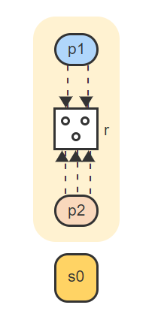
Claim Graph – Visualized – 1
The initial claims are 2 units of r by p1 and 3 units of r by p2

Slide 45
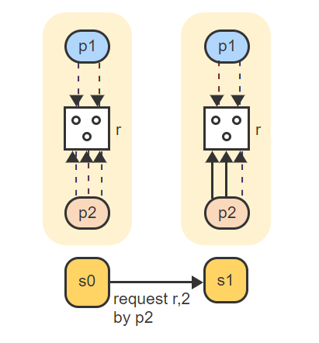
Claim Graph – Visualized – 2
If p2 requests 2 units of r, 2 claim edges turn into actual request edges

Slide 46
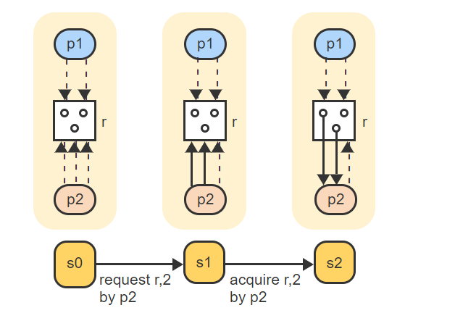
Claim Graph – Visualized – 3
r has free units and thus the request edges turn into allocation edges

Slide 47
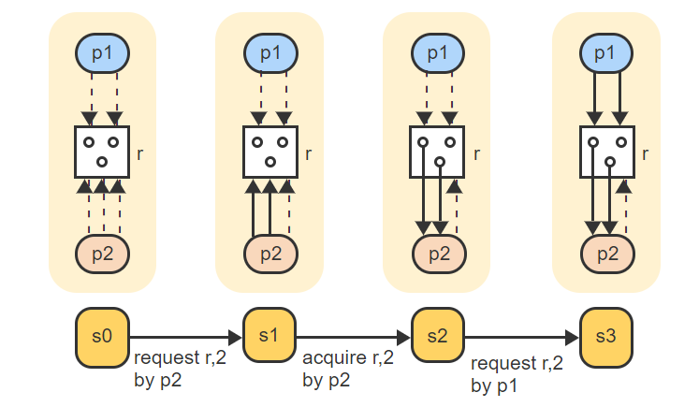
Claim Graph – Visualized – 4
p1 now requests 2 units of 3, which turns the claim edges into actual request edges

Slide 48
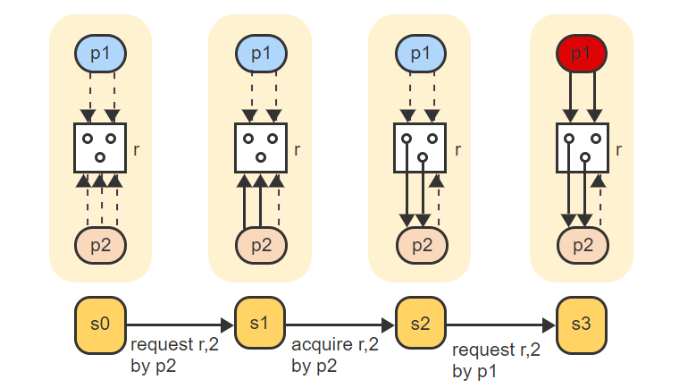
Claim Graph – Visualized – 5
Only 1 unit of r is available and so p1 becomes blocked

Slide 49
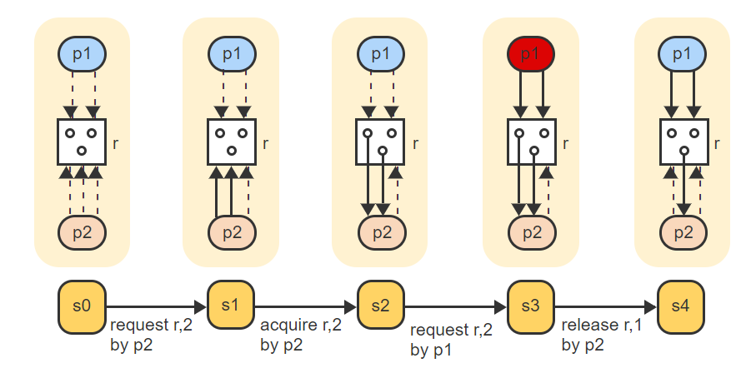
Claim Graph – Visualized – 6
A release of 1 unit of r by p2 reverts an allocation edge into a claim edge and p1 becomes unblocked again

Slide 50
Deadlock Avoidance Algorithm: The Banker’s Algorithm
The banker's algorithm emulates the strategy used by a bank when issuing loans.
A loan corresponds to a resource allocation and a maximum claim corresponds to the credit limit of a customer (requesting process).
The bank grants a request as long as a sequence of loans exist that would satisfy the needs of all customers in some order.
Otherwise, the granting of the request is postponed.

Slide 51
The Banker’s Algorithm
The banker's algorithm:
Given a resource request in a state s, temporarily grant the request by changing the request edges to allocation edges.
Execute a graph reduction on the new state s'.
If the graph of state s' is completely reducible then accept s' as the new state. Otherwise disallow the acquisition by reverting to state s.
Theorem:
If acquisition operations that do not result in a completely reducible claim graph are not executed then any system state is safe.

Slide 52
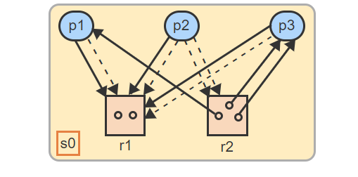
The Banker’s Algorithm – Visualized – 1
In state s0 each of the 3 processes has an outstanding request for 1 unit of r1.

Slide 53
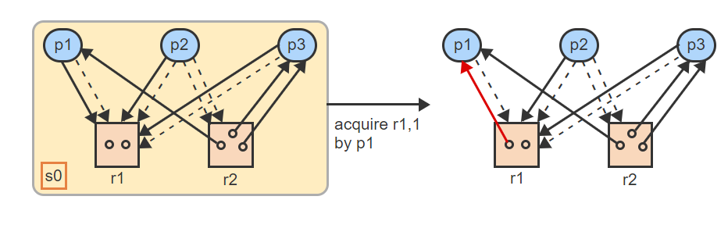
The Banker’s Algorithm – Visualized – 2
To determine if p1's request can be granted, the banker's algorithm grants the request temporarily

Slide 54
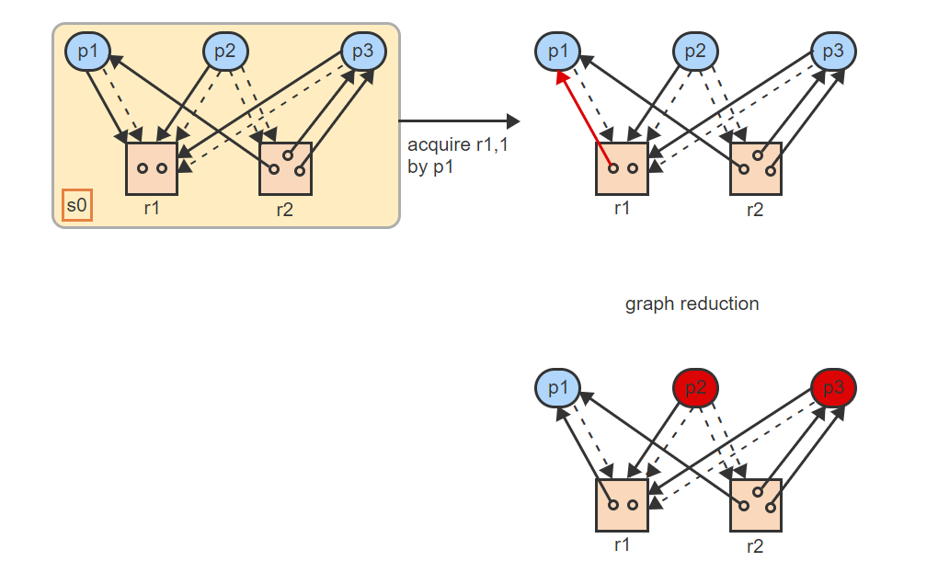
The Banker’s Algorithm – Visualized – 3
For the purpose of graph reduction, all claim edges are treated as request edges, which blocks p2 and p3

Slide 55
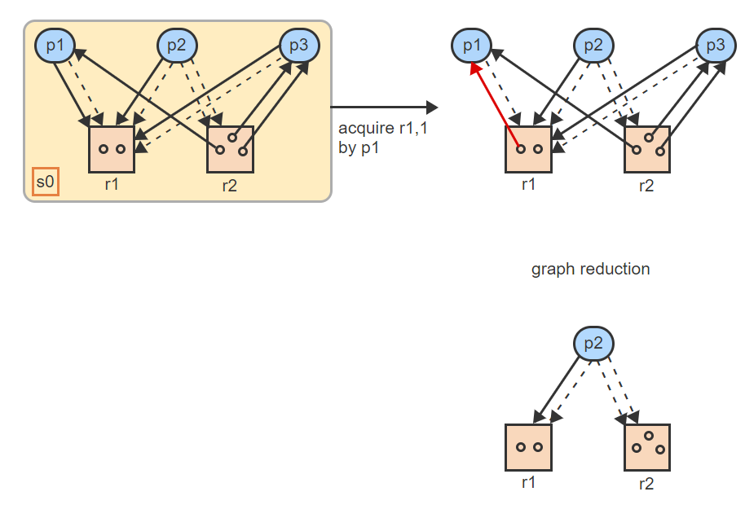
The Banker’s Algorithm – Visualized – 4
The removal of p1 unblocks p3, whose removal in turn unblocks p2

Slide 56
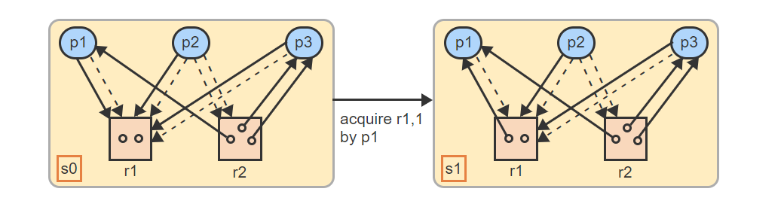
The Banker’s Algorithm – Visualized – 5
Since the graph is completely reducible, the new state s1 is accepted as a valid state

Slide 57
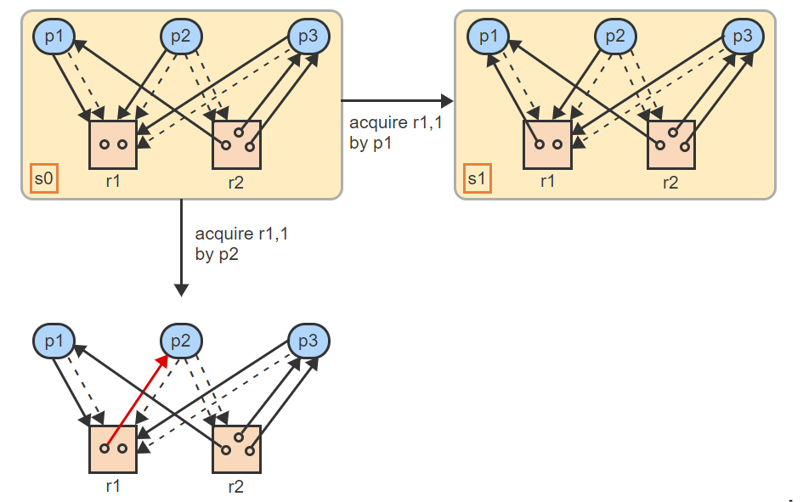
The Banker’s Algorithm – Visualized – 6
To determine if p2's request can be granted, the banker's algorithm grants the request temporarily

Slide 58
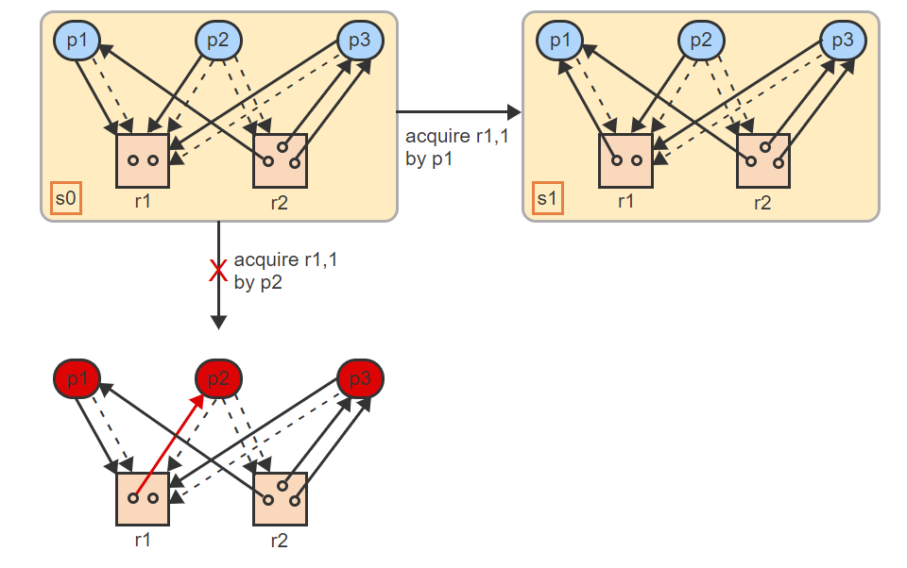
The Banker’s Algorithm – Visualized – 7
When claim edges are treated as request edges, all processes become blocked. The graph is not reducible, and the acquisition is not allowed. The state reverts back to s0

Slide 59
Deadlock Avoidance W/ Single-Unit Resources
With single-unit resources, a process p can be blocked only if p is waiting for a resource held by another blocked process p’.
Since p' is blocked, p' must be waiting for another resource held by yet another process p", etc.
To make the chain irreducible in the claim graph, the processes must be blocked in a directed cycle.
The banker's algorithm is then simplified:
Given a request for a resource in a state s, temporarily grant the request by changing the request edge to an allocation edge.
Starting with the requesting process p, determine if the graph in the temporary state s' contains a directed cycle.
If no cycle exists, then accept s' as the new state. Otherwise disallow the acquisition by reverting to the state s.

Slide 60
Static Deadlock Prevention
Conditions for a deadlock, Two conditions must hold for a deadlock to occur with reusable resources:
Hold and wait: A process is already holding one resource and is requesting another resource.
Circular wait: A process must issue a resource request that closes a cycle involving at least two processes and two resources.
Deadlock is structurally impossible if either of the two conditions are eliminated.

Slide 61
Eliminating Hold & Wait
Several alternatives to eliminating the hold-and-wait condition exist:
Every process must request all resources ever needed at the same time. → Poor resource utilization
Every process must release all currently held resources prior to making any new request. → Better resource utilization but has a higher number of repeated requests and released.
A process can be given the ability to test whether a needed resource is currently available. The process must release all currently held resources only if the requested resource is not currently available. Otherwise the new resource may be requested and allocated immediately.

Slide 62
Eliminating Circular Wait
A cycle in the resource graph can be closed only when two or more processes request the same resources but in a different order. A circular wait is prevented if all processes are required to request all resources in the same order.
One approach is to assign a sequential ordering, seq, to all existing resources, such that seq(ri) ≠ seq(rj) for all i ≠ j. All processes are then required to request resources in only increasing sequential order:
A process p already holding a resource ri with the sequence number seq(ri) may only request resources rj where seq(ri) < seq(rj).
If all processes follow the rule then circular wait is prevented.

Slide 63
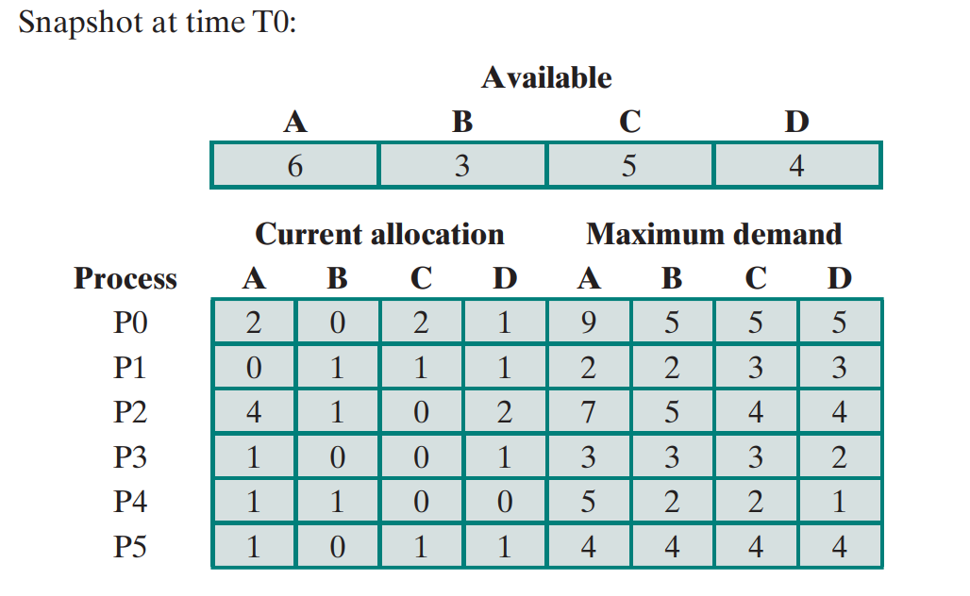
Banker’s Algorithm Exercise

Slide 64
Banker’s Algorithm Exercise
Given the following Current Allocation, Maximum Demand, and Available Resources:
A- Verify whether the available array was calculated correctly.
B- Calculate the Need Matrix
C– Show that the current state is safe, that is, show a safe sequence of processes.
D-Given the request (3,2,3,3) from process P5, should this request be granted? Why?

Slide 65
Banker’s Algorithm Exercise – A
A- Verify whether the available array was calculated correctly.
How can we achieve that?
Count all the processes currently allocated to A.
P0= 2, P1 = 0, P2 = 4, P3=1, P4=1, P5=1, available resources= 6
Then subtract current allocation from total current allocation + available resources
15 – (2+0+4+1+1+1) = 6 hence the available Array for A at least has been calculated correctly.

Slide 66
Banker’s Algorithm Exercise – B
B - Calculate the Need Matrix
Need Matrix = Max Matrix – Allocation Matrix
Maximum Demand
A | B | C | D
9 | 5 | 5 | 5
2 | 2 | 3 | 3
7 | 5 | 4 | 4
3 | 3 | 3 | 2
5 | 2 | 2 | 1
4 | 4 | 4 | 4
Current Allocation
A | B | C | D
2 | 0 | 2 | 1
0 | 1 | 1 | 1
4 | 1 | 0 | 2
1 | 0 | 0 | 1
1 | 1 | 0 | 0
1 | 0 | 1 | 1
Need
A | B | C | D
7 | 5 | 3 | 4
2 | 1 | 2 | 2
3 | 4 | 4 | 2
2 | 3 | 3 | 1
4 | 1 | 2 | 1
3 | 4 | 3 | 3

Slide 67
Banker’s Algorithm Exercise – C
C - Show that the current state is safe, that is, show a safe sequence of processes.
Check if safe by using this algorithm:
If (need <= available) then run
Else if (need > available) then don’t run (move on to the next process)
Need
A | B | C | D
7 | 5 | 3 | 4
2 | 1 | 2 | 2
3 | 4 | 4 | 2
2 | 3 | 3 | 1
4 | 1 | 2 | 1
3 | 4 | 3 | 3

Slide 68
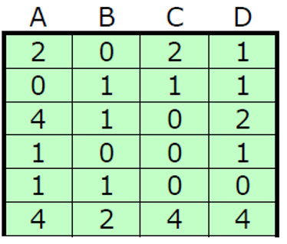
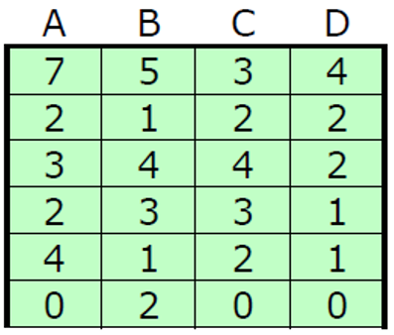
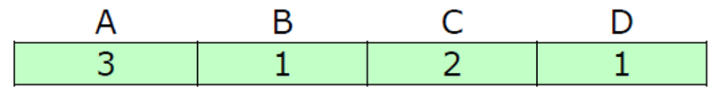
Banker’s Algorithm Exercise – D
D - Given the request (3,2,3,3) from process P5, should this request be granted? Why?
We should not grant this request because the new matrix allocation, the new need matrix, and the available resources would be (respectively from left to right):

Slide 69

Midterm Information
We have a midterm next week.

Slide 70
Midterm General Information
The midterm is scheduled to be conducted at 10AM EST on the 5th of March.
The midterm will be released at 10AM and must be submitted by 12PM (noon).
A 2 point per minute late penalty will be applied if it is not submitted by 12PM.
Before the midterm begins, we will meet on MS Teams (NOT ZOOM) to discuss the instructions.
That meeting will begin at roughly 9:45AM.
Any questions you have during the midterm, you can ask me on MS Teams in a private chat or in the public meeting we are in.
Zoom does not offer us the ability to share content privately.
If I grant an extension on the midterm, it will be announced on MS Teams, so be sure to stay logged in.
I will not handle questions via email (too much of a delay).

Slide 71
Midterm General Information
What sort of questions can you expect?
You will have a mixture of theoretical questions in short answer format and calculation questions (similar the Banker’s Algorithm exercise we just went through). You will also have an exercise to complete in C.
Short answer questions can be satisfied with a paragraph or two with solid examples.
Some of the questions will require you to draw a diagram
Think of a scheduling question for example.
No handwriting/scanning is permitted.
You must show your steps/the formula that you used to explain your calculation questions, simply having the correct answer will not count.

Slide 72
Midterm Content
What is fair game?
Chapter 1 (Introduction)
Chapter 2 (Processes, Threads, & Resources)
Chapter 3 (Scheduling)
Chapter 4 (Concurrency)
Chapter 5 (Deadlock)
Labs
Lecture Slides
Assignments

Slide 73
Midterm Office Hours
I will make myself more available before the midterm as usual; to make sure all your questions are answered.
The extra office hours for the midterm are Wednesday March 3rd 2-4PM AND Friday March 5th at 9AM-9:45AM if you have any last minute questions.

Slide 74
Midterm Academic Dishonesty
Versioning
Plagiarism Scans
Consequences
Let me share a quick story with you.

